Slide 1

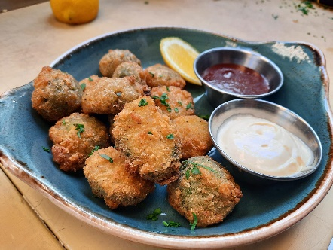

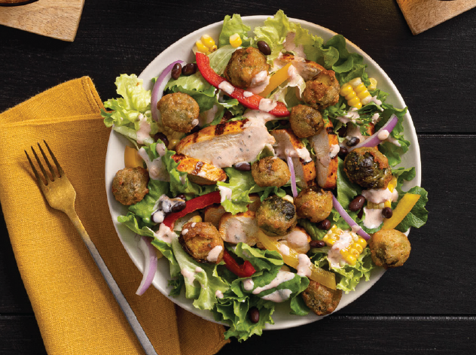
Stocking Sheet
SKU # 1000010831
Description | Lightly-seasoned Brussels sprout halves with a crispy crust, V’DGZ™ Bruss’lz are a great addition to any menu. These Bruss’lz aren’t the Brussel Sprouts that you hated as a kid, with a crispy crust and flavorful center they are a versatile product that shines as a great item to incorporate across your menu.
Versatility Across the Menu – This versatile item is a delicious addition in all aspects of the menu. Whether you pair with a sauce as an appetizer, add it as a trade-up side option or incorporate it into an entrée – like crispy crouton alternatives in a salad, the opportunities are truly endless Cooking options– These are easy to Deep Fry or Bake in Convention Oven, to help meet whatever the needs of your chefs and customers!
Item Code | 1000010831
12-Digit UPC | 072714008214
14-Digit Code | 10072714008211
Case Pack | 4/3 lbs. poly bags in a corrugated shipping case
Case Net Wt. | 12 lbs.
Case Gross Wt. | 13.16 lbs.
Case Cube | .806 c.f.
Case Dimensions | 16.0” x 12” x 7.25” (LxWxH)
Pallet Dimensions | 48” x 40” x 92” (LxWxH)
Cases/Layer | 10 cs.
Layers/Pallet | 12 layers
Cases/Pallet | 120 cs.
Cooking Instructions - from Frozen | Caution: ice crystals on frozen food can cause spattering when added to hot oil. Add product carefully. • Product must be fully cooked. • Do not allow product to thaw. Cooking instructions Deep fry: fry frozen product at 350° f for 3 ¾ minutes. Convection oven: preheat oven to 450° f with low fan. Place frozen product in a single layer on a sheet Pan and bake for 10 minutes. Not designed for microwave preparation. Caution: product will be hot.
Avg PC Ct (LB): L/H (Avg) | 40-50
Operator Price/PC | $0.12
Operator Price/Serving (16 Pieces) | $1.93
Brussl’z Appetizer with
dipping sauce
Spicy garlic Brussl’z appetizer with dipping sauce
Entrée as a Tex-Mex
chicken salad with
Brussl’z croutons
McCain DC’s | Price/ Case | Price/ Lb.
Plover WI | $ 52.30 | $ 4.358
Atlanta GA | $ 53.08 | $ 4.423
Burley ID | $ 53.56 | $ 4.463
Fort Worth TX | $ 53.44 | $ 4.453
Grand Island NE | $ 52.96 | $ 4.413
Hatfield PA | $ 52.96 | $ 4.413
Rochelle IL | $ 52.48 | $ 4.373
Prices estimated based on FOB/Freight/Distributor Mark Up
Available for order starting 1/13/2023
©McCain Foods USA 2022

