Slide 1

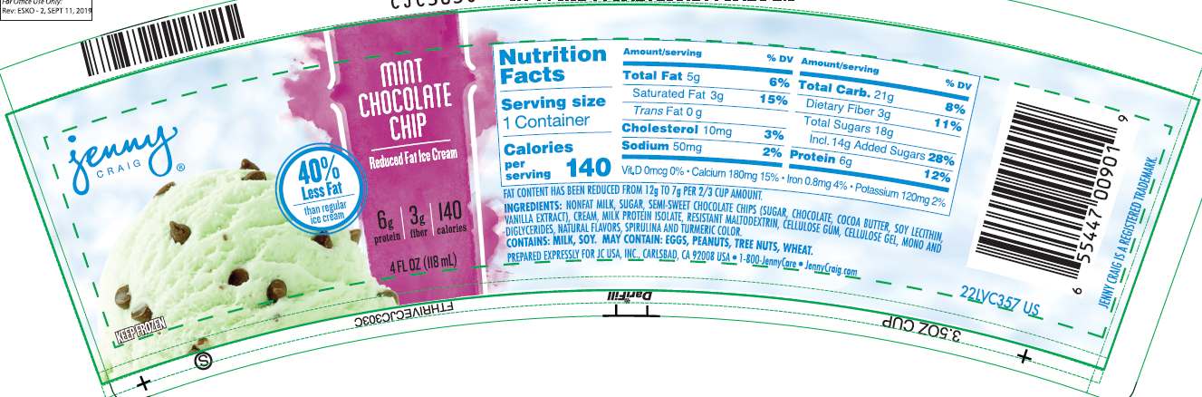
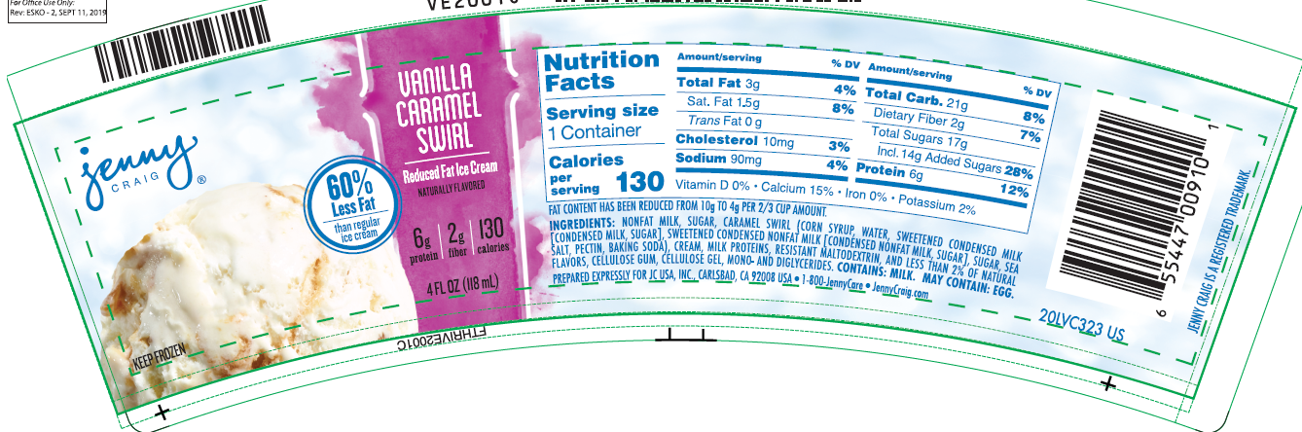
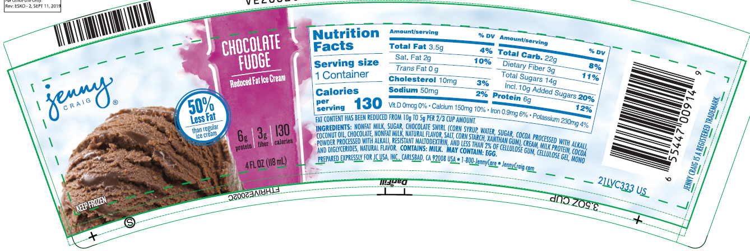
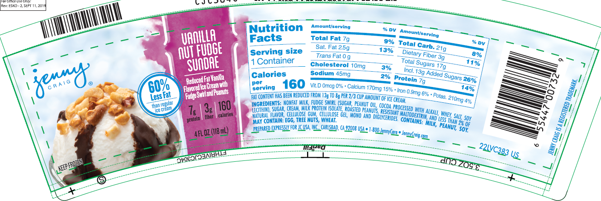
Ice Cream Inventory Offer
Exclusive offer to purchase premium Jenny Craig Ice Cream Product leading up to prime summer season
  Mint Chocolate Chip
  Chocolate Fudge
  Vanilla w/Caramel Swirl
  Vanilla Nut Fudge Sundae
Available Flavors and Nutrition Facts
Reduced fat, premium flavor profile
  Multiple flavors that have been enjoyed by thousands of health-conscious Jenny Craig customers
  Proven formula and demand as Jenny Craig expanded flavor offering several times over multi-year relationship
  Significant product shelf life remaining
Technical Specifications
Offer
Flavor | Cases | Price
Mint Chocolate Chip | 1,791 | $18.00/case OBO
Chocolate Fudge | 2,141
Vanilla w/ Caramel Swirl | 2,027
Vanilla Nut Fudge Sundae | 1,409
Contact: Jeff Holtz jholtz@thriveicecream.com or 501-281-0177

